Slide 1
ISSD PARENT GENERAL ASSEMBLY (PGA)
May 17, 2016

Slide 2
Agenda
Introduction
Staff hiring update
Finances and fee schedule
PTO update
Parents' survey results
School update
Q&A

Slide 3
Introduction
Current members of BOE and their responsibilities:
Tauseef Kazi – Chair, expansion and QIAS
Tamer Kadous – Vice chair, HR and curriculum
Futema Jafri – Treasurer
Rawah Ghabayen – Gen. Sec., facilities, comm. and PR
Ayesha Jafri – HR and curriculum
Yousuf Mostafa – HR and curriculum
Ahmad Kholaif – Communications and PR
Members whose term has expired:
Ahmad Kholaif
Yousuf Mostafa
Former members who are still helping out:
Syed Ali – Facilities
Nasser Alameddin – Managing the new facility

Slide 4
BOE Roles and Responsibilities
Financials
Formulating yearly budget, salaries and tuition
If needed, raising funds for operations and expansion
Working with Principals to set goals and policies
Formulate rules and procedures for school’s operation
Improve quality of education and productivity of staff
Overseeing yearly curriculum and admissions policies
Hiring and evaluating the school Principals and working with the Principals to hire, evaluate, and determine increments of all paid staff
Expansion and setting long term school direction
BOE is NOT involved in day to day school operations

Slide 5
Principals and Staff Hiring Update
Tamer Kadous

Slide 6
New Administration
Have been looking for Principal candidates since January
In addition to running school affairs, the plan is for new Principal to prepare the school for the next phase with the new school
After announcements, we screened/interviewed a number of good candidates
After final ranking we extended an offer to Br. Cemil Gulseven from Oklahoma
Principal’s background
B.SC in Civil Engineering, Bachelor of Shari’ah Islamic Law, Master of Elementary Education, Master of Bilingual Education
Ph.D. Educational Studies: Department of Educational Leadership & Policy Studies – Ongoing
Close to 15 years of experience in Islamic schools in two schools between teaching, VP and Principal positions
In addition, to help serve school’s needs, we opened the floor for VP position from within staff. After interviewing applicants, the BOE selected Sr. Malika Harizi
Starting next year, Sr. Malika will be part time teacher, part time VP (already factored in staffing)

Slide 7
New Year Staffing
At this point it seems we need to hire around 2.5 teachers
Main criteria include:
Strong preference to certified teachers (or ongoing certification) followed by non-certified ones if need be
Teaching experience with similar classroom size
A number of good candidates have applied, and interviewing started last week
In addition to material knowledge, interview focuses on presenting practical situations and ask for teacher’s approach
We did encounter a number of very promising candidates
We expect to be almost done by end of the school year

Slide 8
Financial Update
Futema Jafri

Slide 9
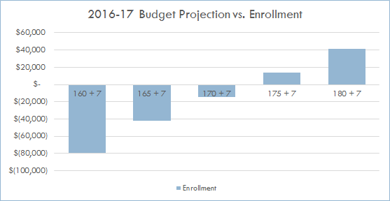
Projected Finances
2016-17 School Year
Enrollment to date: 145 plus 5 in Pre-K = 150 total
Projected budget deficit by end of FY: ($31,000)*
Next Year’s Projections
Assuming various enrollment numbers, projections are as below:
* Assuming enrollment of 167 + 7 TK to factor in student attrition due to relocation/financial hardship.

Slide 10
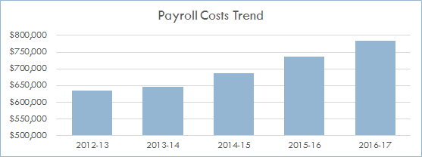
Tuition
Tuition Increased – yes it did - to be re-evaluated each year
2015-16 tuition = $540 (no increase)
2016-17 tuition = $570 rather than $580 proposed in Oct-15 PGA meeting ($30 / 5% increase)
Break-even with 172 + 7 TK students factoring in estimated annual expenses
2017-18 tuition = $600 ($30 / 5% increase)
2018-19 tuition = $630 ($30 / 5% increase)
Reminder - why is tuition increasing? Staff salary increments, hiring certified qualified teachers, increasing security costs, investing in management

Slide 11
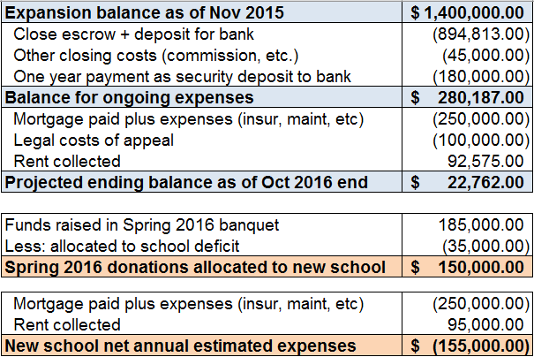
Expansion – The Numbers
Value of the property - $2.775M for 4.28 acres & 10,752 sq. ft.
Your donations at work – recap of expansion financials since acquisition

Slide 12
PTO Update
Rawah Ghabayen

Slide 13
PTO Update
Chair, Vice Chair, Treasurer, Secretary
97 members; 88 on WhatsApp
Accomplishments:
Nasheed Club
TaeKwonDo
PTO Expo
Sports Day
Citizenship
Movie Day
Bake Sale
International Food Fair
Wednesday Fun Activity Day
Welcome Ramadan Activity
Teacher Appreciation Week
Please be aware that PTO is an independent organization so all PTO related concerns and issues should be directed to PTO officers.

Slide 14
Parents’ survey results

Slide 15
Parents Survey 2016 – summary
Max responses from
KG, congrats!

Slide 16
Parents Survey 2016 - Comments
A total of 96 unique responses received (4 duplicates - KG).
A lot of praises along with some negative remarks for our teachers, interim principal and vice principal, staff, admin assistant, security guard and after school activities.
Need to improve English education
Some complains about lack of parent/teacher communication
Homework load is too much
No enough focus on Quran recitation, understanding, tarbiyah and Arabic language
Need for extra curricular activities - on going (Taekwondo, Spelling Bee, Science fair, Robotics, etc).
Need for more/quality P.E. activities during school time.
More lunch supervisors - completed.
Facility: cleanliness of restrooms and lunch tables
Not so positive comments about BOE
Need permanent highly qualified Principal/VP

Slide 17
School Update
Tauseef Kazi

Slide 18
Our ESLRs

Slide 19
Communication Protocol
In case there is an issue with a teacher/PTO
Talk to the teacher/PTO first
If unresolved, talk to the Principals
If unresolved, contact the BOE
Anyone who bypasses a step will be sent back to complete that first

Slide 20
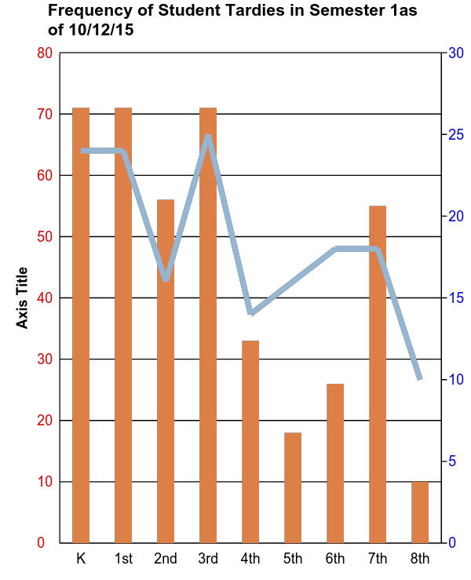
Tardiness is still a problem
The Problem
Disrupts Instruction
Causes students stress, embarrassment, inability to focus
Students miss important parts of the lesson

Slide 21
Tardiness Policy Revision
Consequences
Tips for Being on Time
Lowered schoolwide citizenship grade
3 tardies count as 1 unexcused absence
Chronic tardiness to result in school suspension
Impact on re-enrollment
May be reported to school agency
Bedtime/lights out, unplugged ½ hour earlier
Have clothes and backpacks ready before bedtime
Wake children up ½ hour earlier
Plan to be at school at 7:30 a.m. not 8:00 a.m.
Use privileges as incentives/consequence

Slide 23
Accomplishments 2015-16 (1/2)
Science Fair Results 2016-2107
26 students from 7th and 8th grades participated
Library Essay: 2 winners from 4th grade.
Spelling Bee (with other Islamic schools):
Two 1st place winners
One 2nd place winner
1st Place | 9 students
2nd Place | 6 students
3rd Place | 9 students
4th Place | 2 students
3 students advance to the State Fair on May 24th
7 students got special awards

Slide 24
Accomplishments 2015-2016 (2/2)
October, FLL Qualifier: All three teams advanced to FLL championship in December.
Tigers 8 : second place in robot design.
Tigers 7: second place in core values and the innovative solution award (the biggest award of the season)
Tigers: second place in robot performance.
March, FLL Cup:
Tigers 7N: champions runner-up
Tigers 6 : best working team award. The picture of this team was used in a Ted Talk as a result of their outstanding performance.
April, Spring showdown:
Tigers 6: second place in robot performance
April, Botball: Our middle school in a competition designed for high school
Tigers 8 : First place in Alliance Match
Tiger 7 : Third place in seeding round and best robot design award with the highest score of the day.
Both teams shared the team spirit award and advanced to the international Robotics competition in Florida this summer InshaAllah.

Slide 25
Quran assessment to start in 2 to 3 weeks

Slide 26
Q & A
Jazak’Allah khair for coming

